Slide 2
Fulbright U.S. Scholar Program:
Opportunities for Faculty, Artists,
Researchers and Professionals
Name and Title
Institute of International Education
Notes:
Update to include your information + any other speakers + the date

Slide 3
Program Overview
Why Fulbright?
Eligibility
Types of Awards
Application Cycle
Submit a Strong Application
Questions
Today’s Presentation
Notes:
(Edit as is necessary for your audience)
Specify that you will focus on U.S. scholar awards for faculty and professionals (FYI for those interested in Student or Visiting Scholar Programs.)

Slide 4
In partnership with 160 countries worldwide, Fulbright offers passionate and accomplished faculty, administrators, artists, journalists, lawyers, and other professionals from all backgrounds an unparalleled opportunity to study, teach, or conduct research.
Our mission is to foster mutual understanding between nations, advance knowledge across communities, and improve lives around the world.
Established in 1946 by Congress, Fulbright is the United States government’s flagship international educational and cultural exchange program.
Fulbright is sponsored by the U.S. Department of State with funding provided by the U.S. Government and administered by the Institute of International Education.
MISSION
A BRIEF HISTORY
Notes:
Fulbright allows people to teach, research and conduct professional projects abroad, but at its core it is a cultural and educational exchange program to accomplish our stated mission.

Slide 5
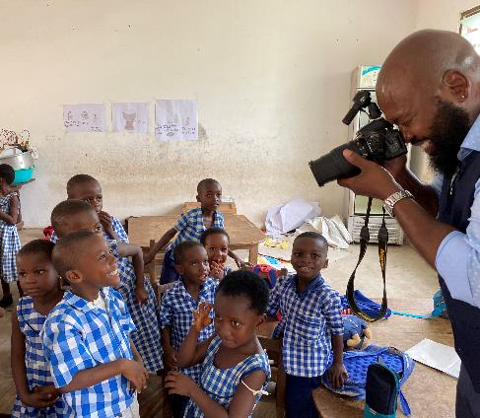
Diversity, Equity, Inclusion, & Accessibility
The Bureau of Educational and Cultural Affairs (ECA) of the United States Department of State strives to embed diversity, equity, inclusion, and accessibility (DEIA) in all aspects of its work. Public diplomacy is most effective when people of diverse backgrounds and perspectives participate in people-to-people exchanges and programs to promote mutual understanding. The Bureau incorporates DEIA best practices throughout its exchanges and programs, grants, community partnerships, and in its workforce and workplace. ECA is committed to addressing barriers based on race, ethnicity, color, national origin, sex, age, disability, sexual orientation, gender identity or expression, religion, geographic location, education, income, socio-economic status, and other diversity dimensions, that may hinder inclusion in the organization. The Bureau’s commitment to DEIA strengthens U.S. foreign policy and is vital to building trust and partnerships here at home and around the world.
Notes:
As a program that “represents the American people”, diversity and inclusion is critical to our work. We strive to have a broad range of American experiences represented by Fulbrighters abroad. With that in mind, we are actively seeking a diverse pool of applicants for the Fulbright program. No matter where you’re from in the US or how you identify, Fulbright welcomes you to participate.

Slide 6
Fulbright by the Numbers
The Fulbright Program funds over 8,000 awards annually:
900
900
2,200
4,000
400
U.S. scholars and administrators
Visiting
scholars
U.S.
students
foreign
students
language teaching assistants
Notes:
While US Scholar is the smallest piece of this puzzle, it is the most strategic. All other programs are possible through the development of relationships that faculty foster while abroad through programs like Fulbright.

Slide 7
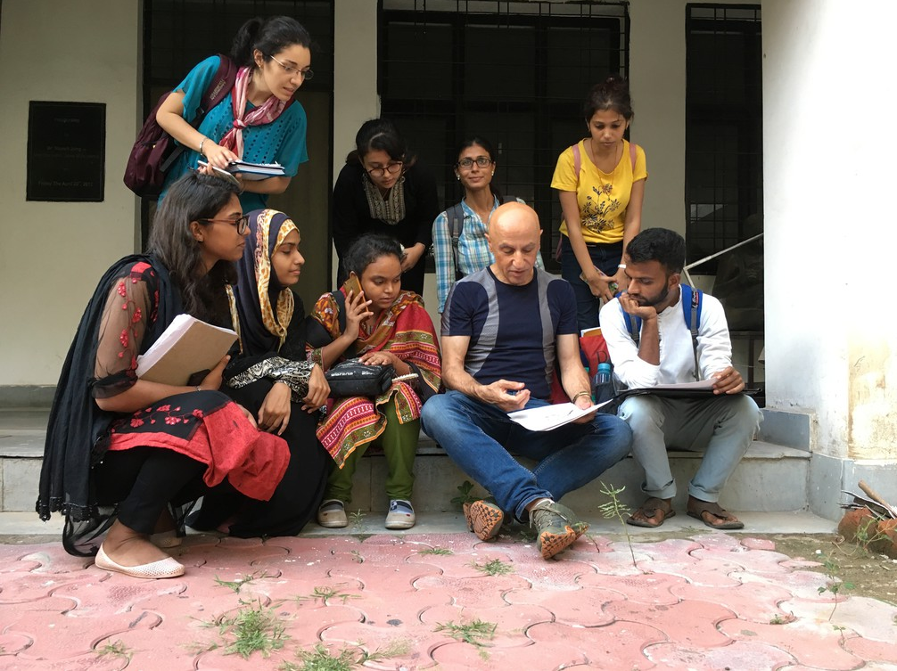
Fulbright U.S. Scholar Awards give opportunities to U.S. citizens to teach, research, carry out professional projects, and participate in seminars around the world.
Why Fulbright?
Fulbright is transformational.
Foster sustainable partnerships
Expand your publishing network and gain new teaching perspectives
Serve as a cultural ambassador
Gain the professional recognition as being identified as a Fulbright Scholar
Join a vibrant and supportive alumni network!
Notes:
Chawky Frenn, U.S. Scholar to India, 2017

Slide 8

Why Fulbright?
Fulbright is family-friendly.
Approximately 60% of our awards provide dependent support
Many Fulbright dependents go on to have international careers
Notes:
Jonathan White, US Scholar to Ukraine, 2015
This makes Fulbright unique among fellowships and grants. Many Fulbright dependents, especially children, are deeply impacted during their time abroad.

Slide 9
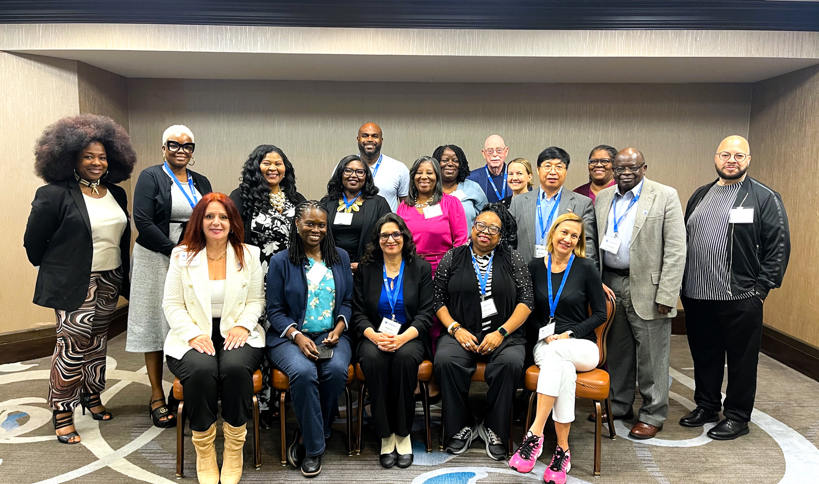
Why Fulbright?
Fulbright is supportive.
70% of applicants engage with IIE staff
Continued support while in country from IIE and host country staff
Access to Fulbright scholar liaisons and alumni as resources
Notes:
Houston scholar liaison training 2023

Slide 10
U.S. citizenship
Degree and experience, as required by award:
      Ph.D. or other terminal degree
      MA and higher education teaching or professional experience
      Professional and/or artistic experience with substantial accomplishments
      Teaching experience as required
Eligibility for U.S. Scholar Program
Fulbright U.S. Scholar alums are eligible; two year waiting period between end of your last Fulbright U.S. Scholar award and next application
Notes:
These are the overall eligibly requirements.
All applicants must have U.S. citizenship at their time of application. There are no exceptions to this; green card holders are not eligible. For the “Degree and experience, as required by award” section, the categories listed are the most common ones seen in the “award requirements” tab.
The official policy on alumni: 2 full years must elapse between the completion of a grant to the application deadline of the next grant. For this fall, applicants applying on September 15, 2023 need to have completed their grants before September 15, 2021 to be eligible in this regard.
Always review award descriptions or contact the Fulbright office to confirm eligibility if you are unsure. This can include questions of allowed disciplines for your award, appropriateness of your career profile (e.g. postdoctoral vs. Distinguished Scholars, etc.) and other factors.

Slide 11
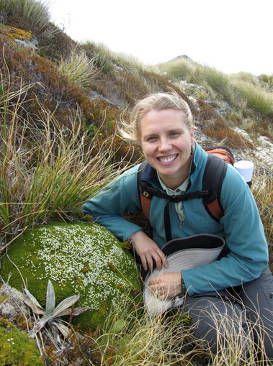
What can a Fulbright U.S. Scholar do? Start by finding your award!
Over 400 individual awards in more than 100 countries to teach, research, teach AND conduct research (listed as teaching/research), carry out a professional project or attend a seminar:
fulbrightscholars.org/awards/search
Select *one award* that suits your profile as a scholar, your project and your goals – and apply!
Notes:
"What can I do?" The answer is in the award!
The way the U.S. Scholar program is structured is that we offer over 400 individual awards across all world regions. You can search awards available on our site based on activity, your own profile, whether you need a PhD and other details. You then select the *one award* you wish to pursue that's a good fit for you and your project and apply!

Slide 12
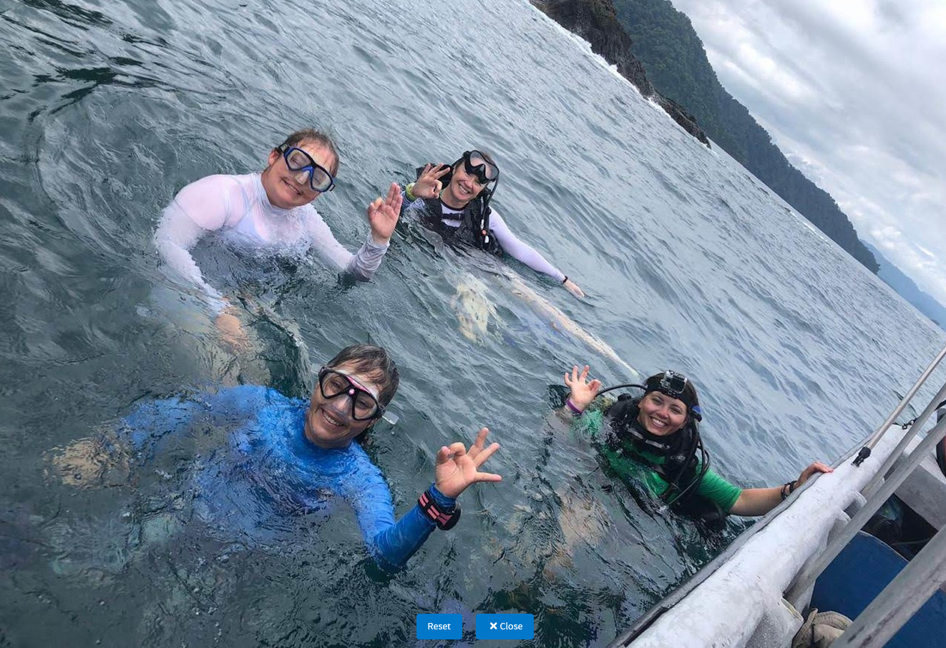
Fulbright U.S. Scholar Awards
Award Types that support research, teaching, and/or professional projects:
Postdoctoral Awards
Scholar Awards
Distinguished Scholar Awards
Awards vary from 2-12 months
Over 60 countries allow for the Flex option, which lets you divide a longer
grant into two to three visits over up to two years, depending on the award.
Notes:
Kerri Seger, U.S. Scholar to Colombia, 2018
Different award categories fall under the umbrella of the U.S. Scholar Program. Those that support teaching, research and/or professional projects:
Scholar awards are by far the largest category, ranging in grant length and professional profile. These can be for postdoctoral researchers to full professors and everyone in between.
Postdoctoral awards are specific to researchers who have completed their PhD within 5 years of the fellowship start date.
Distinguished Scholar awards are intended for more accomplished faculty. Some awards look for those at associate or full professor rank or above – always consult award description
Awards open to FLEX: Available in 63 countries and all world areas, Allows multiple visits over up to two years – CHECK YOUR AWARD. This is a great option for those who may not have the flexibility to be gone for 3-4 months or longer.

Slide 13

International Education (IEA) Administrator Awards
Fulbright International Education Administrator (IEA) Awards: Participate in seminars to learn about a country's higher education system and context!
Open to international education staff and senior-level administrators on U.S. campuses.
Details at fulbrightscholars.org/iea
Notes:
Photo: He Zhang, U.S. Scholar to Uzbekistan and India (SCARRP), 2014
IEA do not support research or teaching, but are unique opportunities for professionals in international education and senior institutional leadership!
IEA awards – for administrators at US campuses to participate in seminars abroad. These are not for faculty and do not support research or teaching, but are excellent opportunities for faculty with administrative responsibilities (such as a dean or chair) and university staff to do a deep dive into another country's higher education system and context. A great opportunity for professional development and improving your institution's international engagement

Slide 14

Selecting the Right Award
Teaching
Match country interest, expertise, career profile, and proposal to the award description
Most awards are for one country, but there also some regional and global awards – check your options!
Language ability (if applicable)
Discipline preferences, when specified
Project relevance to the host country and/or institution
Benefits to you and your community
Research
Teaching/
Research
Professional Project
Remember: you can only apply for ONE AWARD per application cycle
Notes:
Many details vary by award, so always read award description carefully!
Details to note:
Country: Most awards are specific to a single country, but Regional Research Awards exist in most world regions, allowing you to visit 2 or more countries throughout a region. The Global Scholar Award accommodates projects that span 2 or more countries across 2 or more world regions. Check the description!
Career level – early career, mid-career, senior and senior academics, professionals and artists are all categories listed on the award descriptions
Language ability – many awards do not require a language other than English. Check award description’s application requirements section for details!
Scholars can only apply for one award per cycle. If they have difficulty choosing, they should contact the regional staff listed on the award for guidance or attend an office hour.

Slide 15

Application Components
Requirements:
Supplemental Materials:
Application Form
Course outlines or syllabi (for teaching)
Project Statement
Reference list (for research)
Curriculum Vitae or Resume
Portfolio submissions (for artists, architects, and journalists)
2 Letters of Recommendation
Language Proficiency Report (if required)
Letter of Invitation (if required)
Notes:
Note: IEA/FPPF application requirements are a bit different – In lieu of a project statement, applicants submit a series of essays.

Slide 16
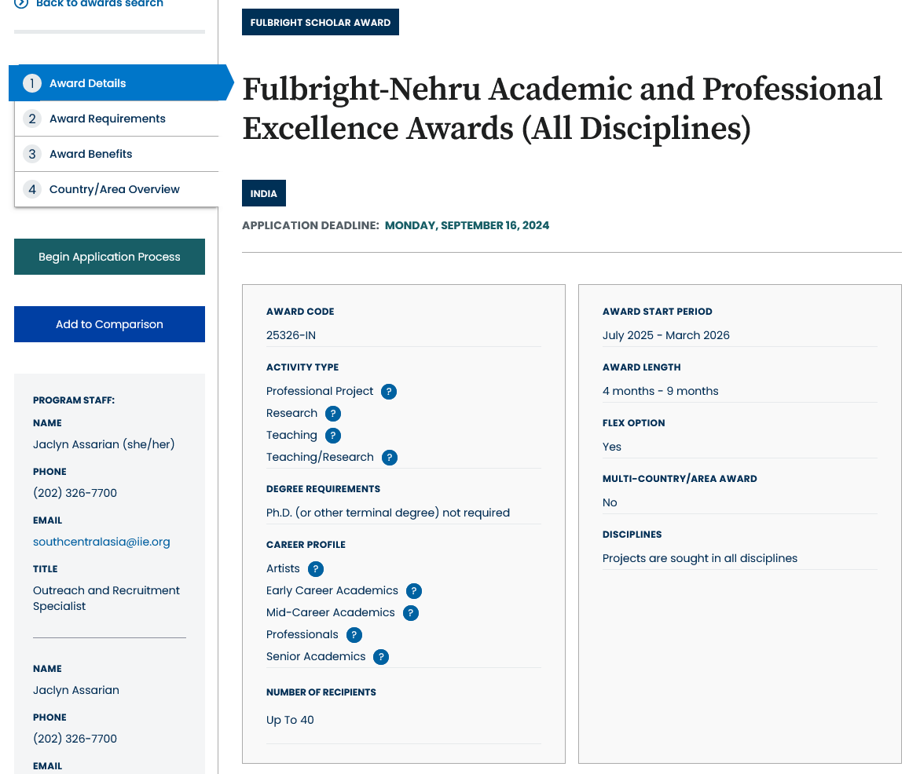
Understanding the
Awards
Visit fulbrightscholars.org to search awards
Review important details in:
award details
award requirements
award benefits
country/area overview
Notes:
Awards are available on FulbrightScholars.org
EVERY AWARD contains 4 parts:
award details
award requirements
award benefits
country/area overview
Potential applicants should carefully read the information on EVERY tab to understand the award completely.
Please encourage scholars to pay specific attention to the “Award Requirements” tab. This provides critical information regarding eligibility, language proficiency requirements, and whether a letter of invitation is required. Note that the Award Details and Requirements tabs often have contacts listed at institutions abroad or the Fulbright office in country.
It's best not answer specific questions about any award requirements because they differ across awards. Remind the audience to consult the “Award Requirements” tab and reach out to the Fulbright office if they have any questions or need clarification.
If time allows at the end, it can be helpful to walk through the website + an award description (plus you can demonstrate how to search)

Slide 17

Tips for a strong application:
READ AWARD’S DESCRIPTION
START EARLY
USE IIE RESOURCES
Before you start, read your award’s description carefully to ensure you meet all requirements and your proposed project is possible.
Start application and enter referees’ information
as soon as possible.
Take advantage of IIE resources, including webinars, office hours and application guidance on our website.
Notes:
Read the description carefully: as obvious as this sounds, you want to make sure what you're proposing is appropriate and you are personally eligible for the award. Confirm all this before you begin!
Start as soon as possible: This will allow you to familiarize yourself with the application system and avoid any last minute panics at the deadline. Also remember that your references are due on the same day as your application (Sept 16), so you want to give your referees as much time as you can for them to submit their letters on your behalf.
We are here to help! We offer resources throughout the competition to guide you through the application process, plus office hours to ask your questions live to IIE staff.
Applicants who follow instructions are always the most competitive.

Slide 18
Application Cycle
The 2025-26 Fulbright U.S. Scholar
Competition: Open in February 2024
FEBRUARY
Competition Opens
SEPTEMBER 16
Application Deadline
SEPTEMBER
Program staff conducts technical reviews for completeness
OCTOBER – NOVEMBER
U.S. peer review
Applicants notified of status. Recommended applications are sent to host countries and to the Fulbright Foreign Scholarship Board.
NOVEMBER – JANUARY
JANUARY – JUNE
Final decisions are made
JUNE – ONWARD
Participants prepare for departure
Notes:
Note that the notification window for hearing final decisions is wide but also accurate. People can year as early as January and as late as the end of May.
**Note: Award timeline for IEA Seminars is different, depending on the award!

Slide 19

Connect with a Fulbright Alumni Ambassador
Official representatives of the Fulbright Program
Share the impact Fulbright had on them personally and professionally, as well as on their institution.
Emeriti Ambassadors
72
New Ambassadors
26
For more information, visit: fulbrightscholars.org/alumni-ambassadors
Events Annually
80+

Slide 20
Bring Foreign Fulbrighters to your Campus
FULBRIGHT SCHOLAR-IN-RESIDENCE (S-I-R) PROGRAM
FULBRIGHT OUTREACH LECTURING FUND (OLF)
FULBRIGHT LANGUAGE TEACHING ASSISTANT (FLTA) PROGRAM
STUDENTS
Host scholars from other countries to teach for a semester or an academic year
Deadline: Proposals due in June to host in the following academic year
Website: fulbrightscholars.org/sir
Email: SIR@iie.org
Host current Fulbright Visiting Scholars for short-term lectureships of 2-6 days on discipline or cultural topics to internationalize the campus
Website: fulbrightscholars.org/OLF
Email: OLF@iie.org
Host native speaking language teaching assistants to enhance students’ understanding different languages and cultures
Website:
foreign.fulbrightonline.org
Email: dcook@iie.org
Notes:
Remember there is an inbound side of Fulbright as well to bring visitors to your campus. All of these programs increase your institution's capacity, whether it's teaching staff or international programs/engagement.
The Fulbright Scholar-in-Residence (S-I-R) Program assists U.S. higher education institutions in expanding programs of academic exchange, by supporting non-U.S. scholars through grants for teaching at institutions that might not have a strong international component and/or serve minority audiences. Both the U.S. institution and the scholar grantee benefit from this experience. This is an ideal program for those who would like to host a visiting professor to teach but don't already have connections to faculty in other countries.
The Outreach Lecturing Fund (OLF) provides funding for campuses to host Fulbright Visiting Scholars, already in the United States, for short-term speaking engagements. To see a list of current Visiting Scholars in the U.S. please visit our Scholar Directory. The OLF travel award is designed to enrich both institutions and Visiting Scholars through lectures that will promote academic disciplines and cultural understanding.
The Fulbright Foreign Language Teaching Assistant (FLTA) Program supports language assistantships at universities and colleges throughout the U.S., providing institutions with an opportunity to enhance their language programming and expose students to native speakers who bring an energetic, up-to-date cultural component to the foreign language classroom as well as student life at a campus in general.

Slide 21
Additional Fulbright U.S. Programs
SCHOLARS
STUDENTS
TEACHERS
STUDENTS
Fulbright-Hays Group Projects Abroad Program GPA@ed.gov
Specialist Program FulbrightSpecialist@worldlearning.org
Fulbright-Hays Doctoral Dissertation Research Abroad Program DDRA@ed.gov
English Teaching Assistant (ETA) Program FBstudent@iie.org
Student Program FBstudent@iie.org
Distinguished Award in Teaching Research Program FulbrightDA@irex.org
Group Projects Abroad GPA@ed.gov
Teachers for Global Classrooms FulbrightTGC@irex.org
Notes:
The U.S. Scholar Program is large but is one of many programs under the Fulbright umbrella. Note that there are opportunities other opportunities for U.S. Scholars, students and teachers to pursue abroad. I encourage people to take a photo or screenshot this to follow up if interested.
U.S. Scholars
Fulbright-Hays Group Projects Abroad Program - Funding to spend time in a foreign country or region acquiring resource materials for curriculum development in modern foreign languages or area studies programs
Fulbright Specialist - The Fulbright Specialist Program is a unique opportunity for U.S. academics and established professionals to join a roster of candidates who are eligible to engage in two- to six-week, project-based exchanges at host institutions across the globe. Institutionally driven from overseas, so projects must be approved for funding abroad before matches take place.
U.S. Students
English Teachign Assistant (ETA) Program - Places grantees in schools overseas to supplement local English language instruction and to provide a native speaker presence in the classrooms
Fulbright-Hays Doctoral Dissertation Research Abroad Program - Funding for individual doctoral students who conduct research in other countries in modern foreign languages and area studies for periods of six to 12 months
Fulbright U.S. Student Program - Recent graduates, post-graduate candidates through dissertation level, developing professionals and artists to study and research abroad
U.S. Teachers
Fulbright Distinguished Award in Teaching Program - K-12 educators can take part in a three-to six-month professional development experience abroad, pursue individual inquiry projects, take courses at a host university, and collaborate with colleagues on best educational practices
Fulbright-Hays Group Projects Abroad - Funding to spend time in a foreign country or region acquiring resource materials for curriculum development in modern foreign languages or area studies programs
Fulbright Teachers for Global Classrooms - Fulbright TGC is a year-long professional development opportunity for U.S. elementary, middle, and high school teachers to develop skills for preparing students for a competitive global economy.

Slide 22

Stay Connected with Fulbright
EMAIL us at scholars@iie.org
VISIT fulbrightscholars.org to learn more about the Fulbright U.S. Scholar Program
REFER your colleagues
Notes:
Sign up for MyFulbright, follow all our social media for inspiration and stories, refer your colleagues!

